Slide 1
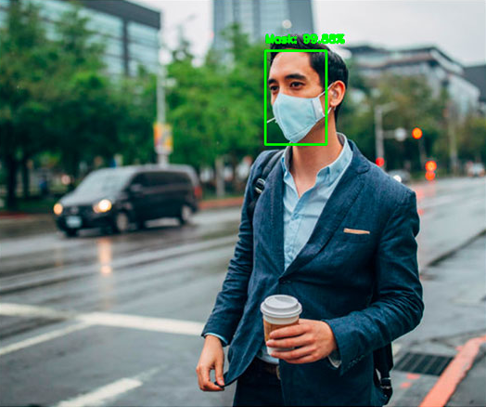
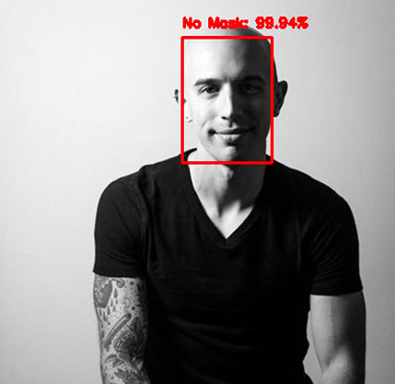
FACE MASK DETECTION USING DEEP LEARNING

Slide 2
Table of Content
TOPICS
NEED FOR FACE MASK DETECTION
INTRODUCTION TO NEURAL NETWORKS
NEURAL NETWORK USING LOGISTIC REGRESSION
CONVOLUTIONAL NEURAL NETWORKS
CAT IMAGE DETECTION USING TENSORFLOW
FACE-MASK DETECTOR
LOOPHOLES AND IMPROVEMENT

Slide 3
Why is face-mask detection required?
Coronavirus as we all are aware is among the most contagious viruses. It is hence required that we all follow certain guidelines like wearing a face mask whenever outside. Social, religious and academic institutions, where there is a large influx of people, requires a robust technique to detect whether all are wearing a face-mask. Hence it is imperative that we develop a computer algorithm to do the same. This eliminates additional manpower and human error.
Why use Deep-Learning?
Implementing a deep-learning algorithm to detect face-masks is very easy and effective. It can work on live-feed images and videos as well as can detect multiple face-masks at a time. It doesn’t necessarily require a real dataset and still performs to the desired level. Most importantly, the code is very user friendly and can be tweaked to accommodate diverse parameters accordingly.

Slide 4
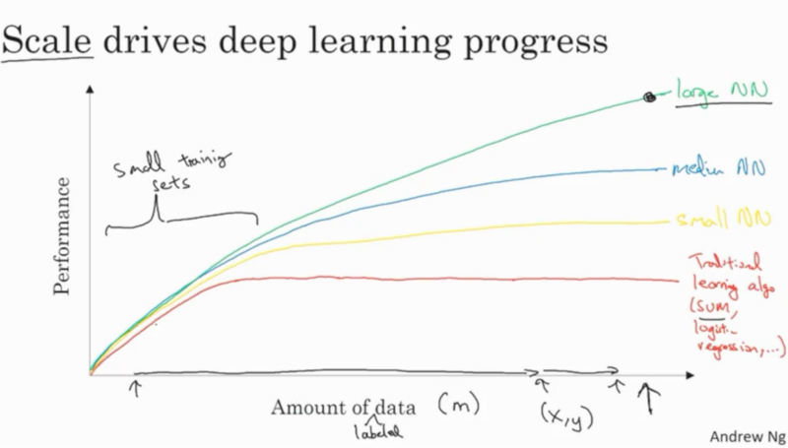
WHY DEEP LEARNING IS BENEFICIAL IN LARGE SCALE OPERATIONS
Source- Coursera, Neural Networks and Deep Learning

Slide 5
Requisites for developing a model:
Python
TensorFlow and Keras
Convolutional Neural networks
Deep Network Learning
OpenCV
Large dataset of masked and non-masked humans
Video stream through web-cam

Slide 6
Plan:
In order to train a custom face mask detector, we need to break our project into two distinct phases, each with its own respective sub-steps:
TRAINING: We’ll focus on loading our face mask detection dataset from disk, training a model (using Keras/TensorFlow) on this dataset, and then serializing the face mask detector to disk.
DEPLOYMENT: Once the face mask detector is trained, we can then move on to loading the mask detector, performing face detection, and then classifying each face as with_mask or without_mask.

Slide 7

Introduction to Neural Networks
Source- Google Images

Slide 8
FORWARD PROPAGATION
The first layer consists of input features. The input features have to be a row vector.
The second layer consists of two computations. They are pre-activation and activation respectively.
Weights(w) are multiplied with the input features in the pre-activation. A bias(b) is also added to their product accordingly. It is denoted by z.
The activation computes the probability of activation of the corresponding neuron. z is the input and the g(z) is the output where g(x) is the activation function.
We often use the ReLU (Rectified Linear Unit) as the activation function in the hidden layers and Sigmoid function in the output layer.
The maximum probability of activation in the output layer is usually the answer of our problem.

Slide 9
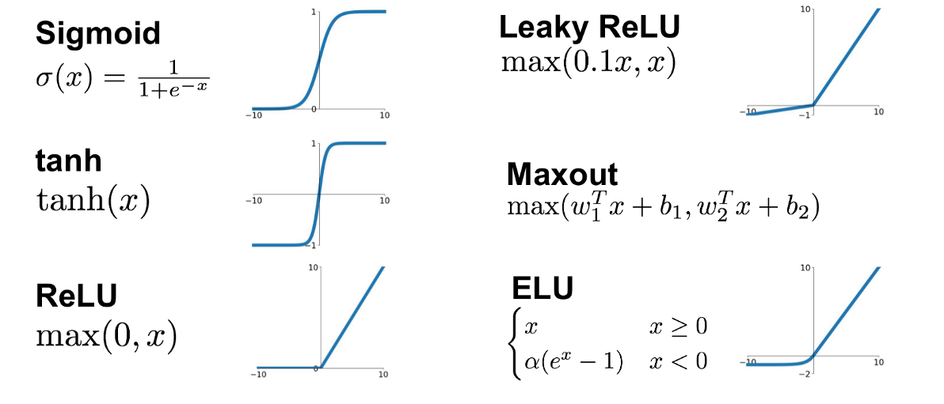
Some Common Activation Functions
Source- Google Images

Slide 10
BACKWARD PROPAGATION
During training, once the output activation is achieved, loss is calculated using the loss function. The loss is respect to the labelled data.
We need to find the change in the loss function with respect to change in the weights and biases.
We are essentially finding the minima of the loss function using a technique known as stochastic gradient descent.
Stochastic gradient descent is a an optimizer algorithm which involves hyperparameters like the learning rate.
There are other efficient algorithms like the binary-crossentropy and the Adam optimizer.
The parameters w and b are updated using k = k – α(dk) where k is the parameter, α is the learning rate and dk is the derivative of the loss function with respect to k.

Slide 11
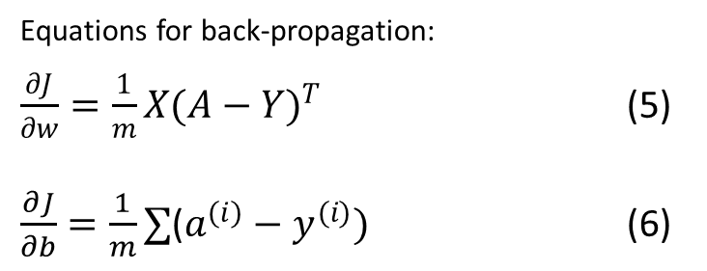
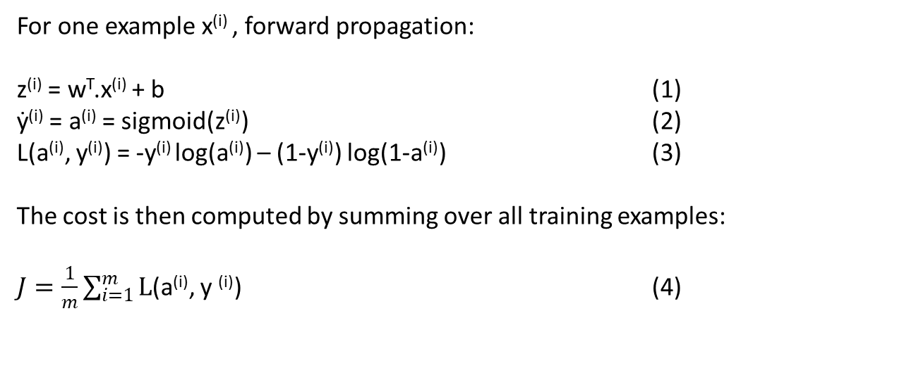
Mathematical expressions of the algorithm:
For one example x^{(i)} , forward propagation:
z^{(i)} = w^{T}.x^{(i)} + b (1)
ẏ^{(i)} = a^{(i)} = sigmoid(z^{(i)}) (2)
L(a^{(i)}, y^{(i)}) = -y^{(i)} log(a^{(i)}) – (1-y^{(i)}) log(1-a^{(i)}) (3)
The cost is then computed by summing over all training examples:
$J=\frac{1}{m}\sum_{i=1}^{m}{L}$(a^{(i)}, y ^{(i)}) (4)
Equations for back-propagation:
$\frac{∂J}{∂w}=\frac{1}{m}X{(A−Y)}^{T}$ (5)
$\frac{∂J}{∂b}=\frac{1}{m}∑$($a^{(i)}−y^{(i)})$ (6)
The superscript (i) denotes the i training example. We use vectorization in deep learning rather than an explicit for-loop due to its efficiency.

Slide 12
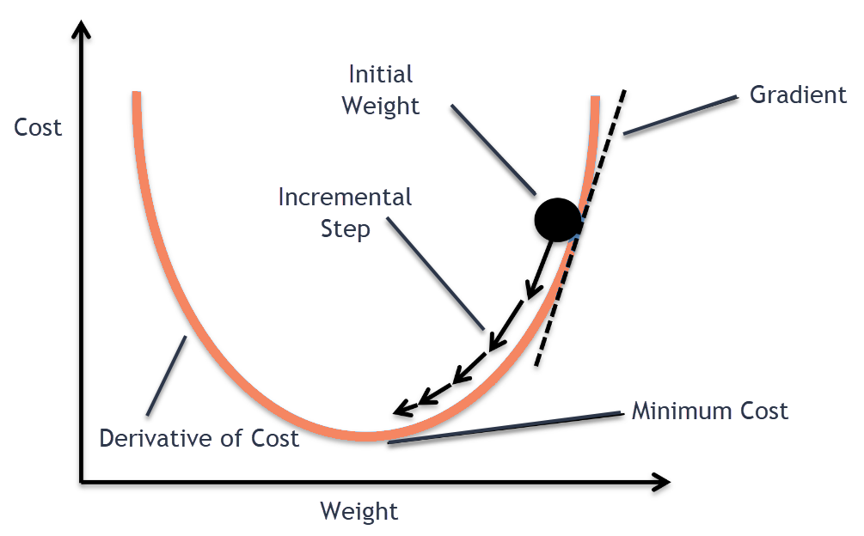
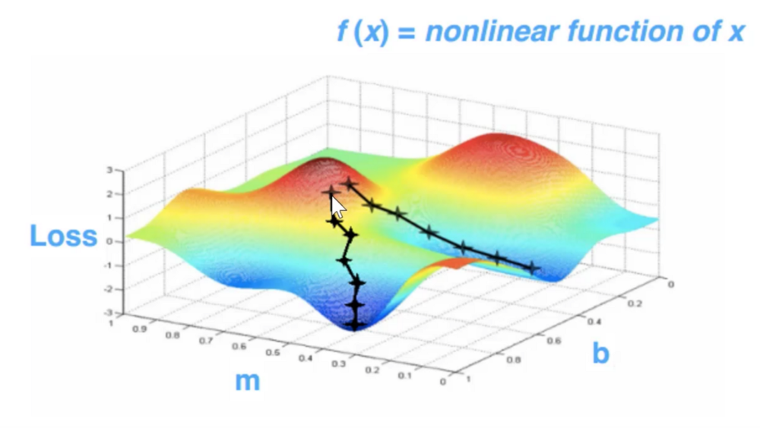
Gradient Descent
Source- Google Images
Source- Google Images

Slide 13
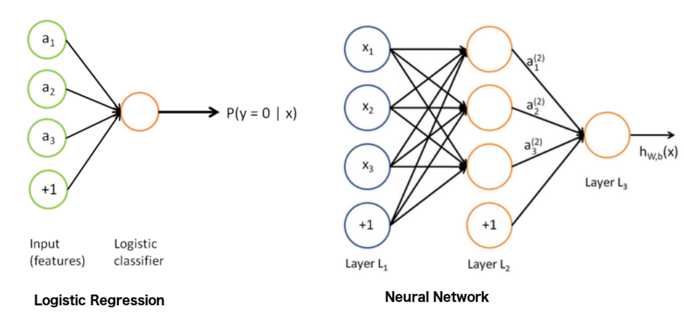
Neural Network using Logistic Regression
Source- Google Images
Source- Google Images

Slide 14

Logistic Regression
In logistic regression we try to divide the data into two broad classes using maximum likelihood estimation. In a nutshell we try to pass the majority of the data points though the S-shaped curve.
Source- Google Images

Slide 15
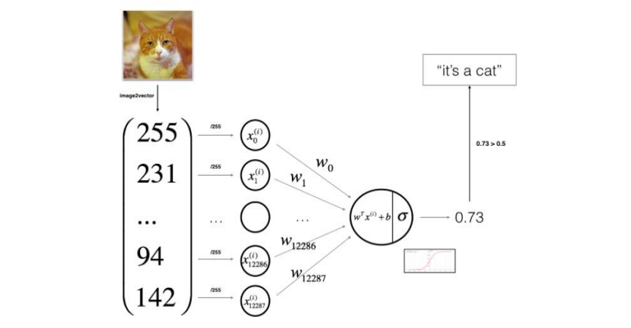
General Architecture of the Training Algorithm
Source- Coursera, Neural Networks and Deep Learning

Slide 16

Why we use TensorFlow and Keras
TensorFlow is a library package in python which is a symbolic math library and has extensive use in the fields of data science and machine learning. The in-built functions make the code reusable and efficient.
Keras is an open-source neural network library written in python which is used on top of TensorFlow. It focuses on being user-friendly, modular and extensible.

Slide 17
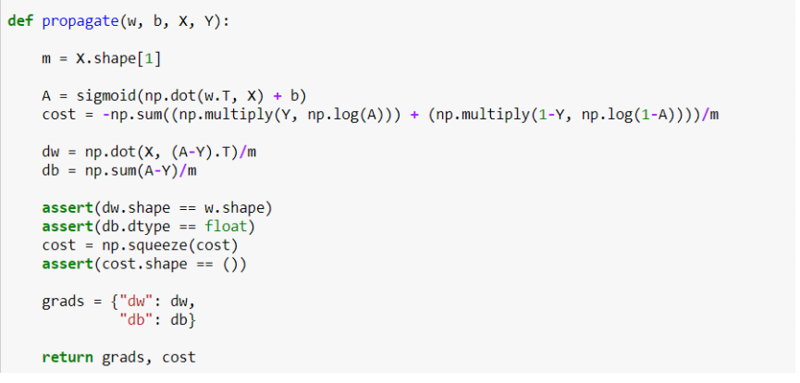
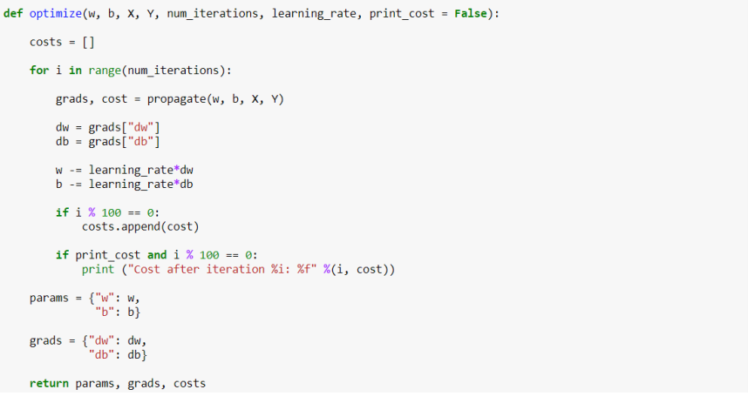
TensorFlow and Keras
An example illustrating the ease of using TensorFlow and Keras:
+
=
tf.keras.layers.compile(loss = ‘binary_crossentropy’, optimizer = ‘stochastic_gradient_descent’)

Slide 18
Convolutional Neural Networks
What are convolutions?
In image processing, convolutions are basically matrix operations on the pixel values to bring out a desired effect in the image.
Why do we need convolutions?
Often images in the dataset aren’t uniform and the characteristic properties of the image can be placed anywhere in the image. Hence we require a technique which can identify the important features of the image and make the image size uniform. Convolutions help condense the information present and reduce the size of the image at the same time. This pre-processing helps in reducing computation time.

Slide 19
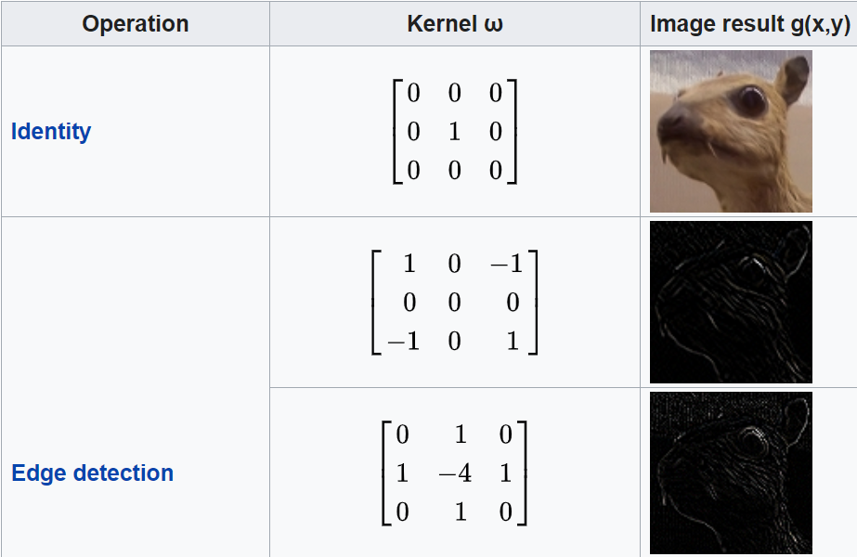
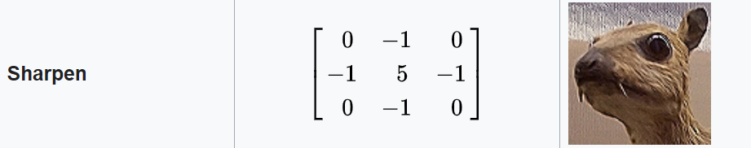
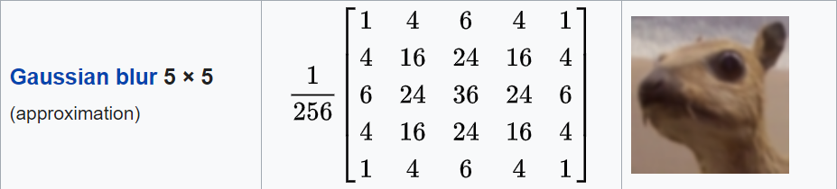
Convolutions and Image Processing
Source- Wikipedia, Kernels

Slide 20

Max Pooling
In the following program we use pooling alongside convolutions. Pooling further reduces the size of the image.
It retains the maximum value of the specified neighbourhood and discards the other pixel values.
Source- Google Images

Slide 21
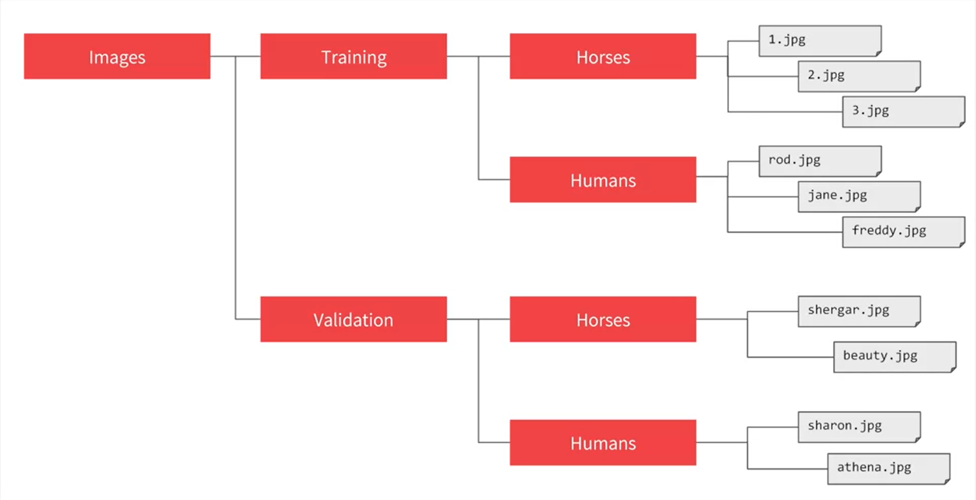
ImageDataGenerator
Another wonderful feature in TensorFlow is its ability to label the datasets based on the sub-directories. Most of the times, the dataset generated are not labelled and it is a very time-consuming activity to label each and every image. In TensorFlow there is already a in-built function ImageDataGenerator which label the datasets.
Source- Coursera, Introduction to TensorFlow for Artificial Intelligence, Machine Learning, and Deep Learning

Slide 22
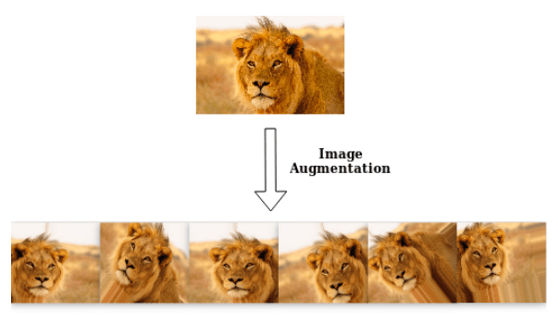
Data Augmentation
Data augmentation is a strategy that enables practitioners to significantly increase the diversity of data available for training models, without actually collecting new data. Data augmentation techniques such as cropping, padding, and horizontal flipping are commonly used to train large neural networks.
Source- Google Images

Slide 23
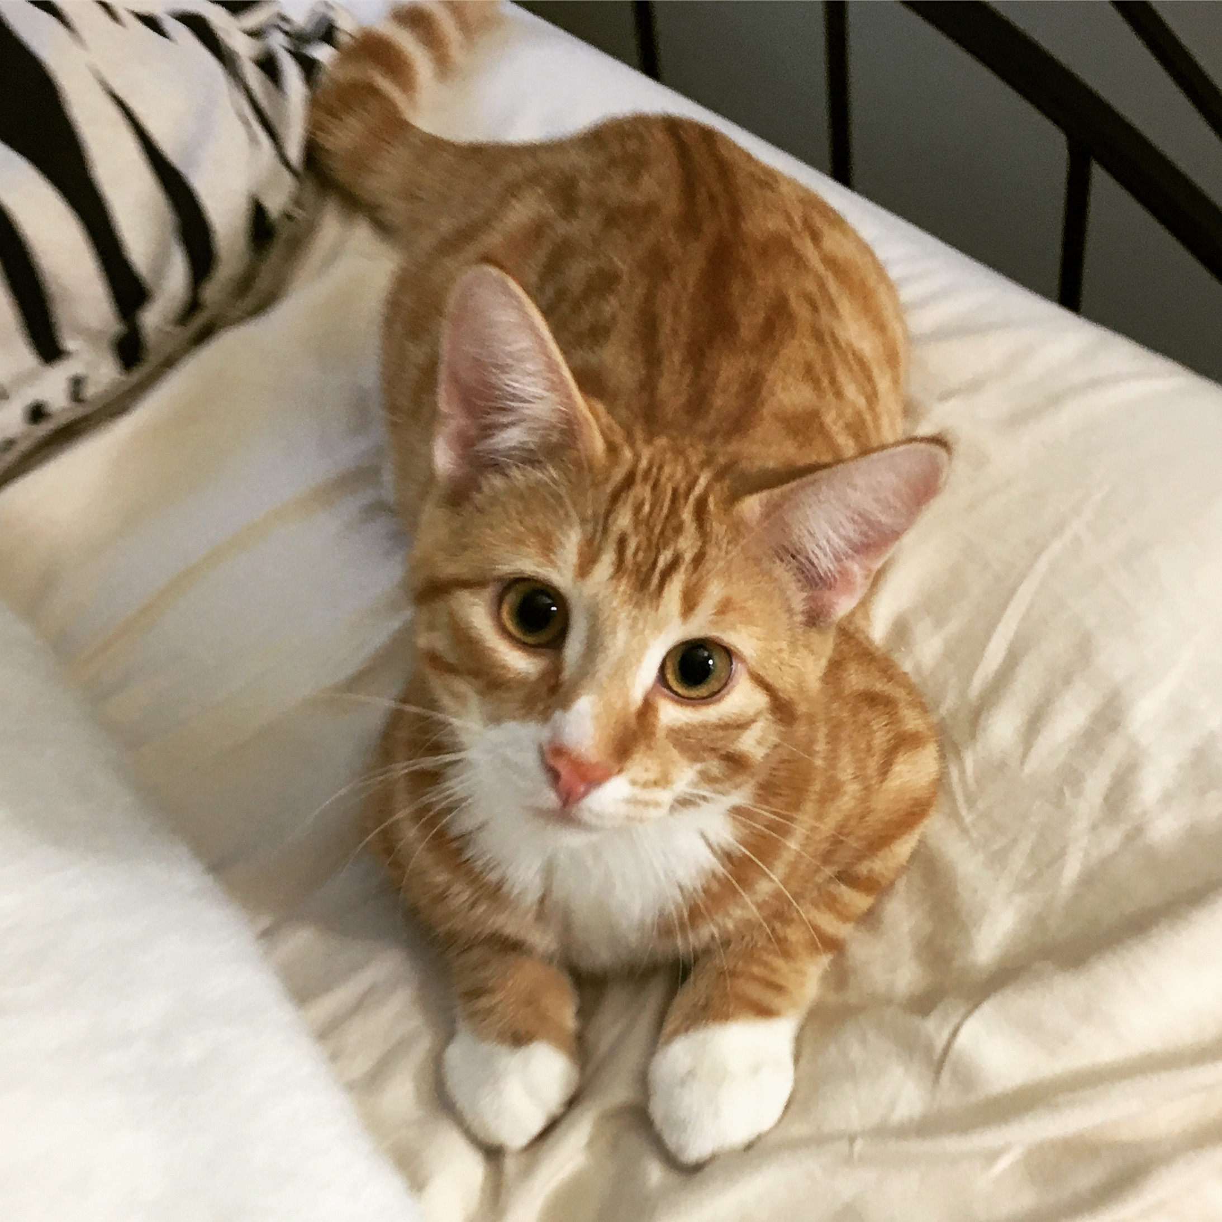
Cat Image Detection using TensorFlow
[1], it is a cat image
Source- Google Images

Slide 24
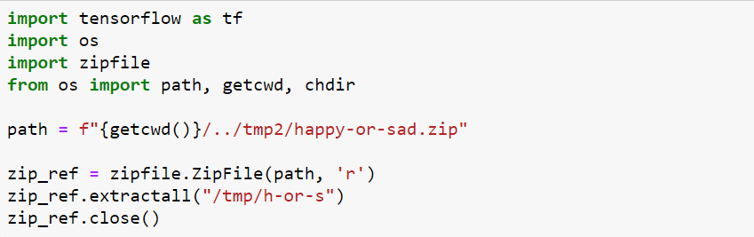
Importing zip files and Extracting them
We first locate the path of the dataset
We use a temporary directory to store the dataset

Slide 25
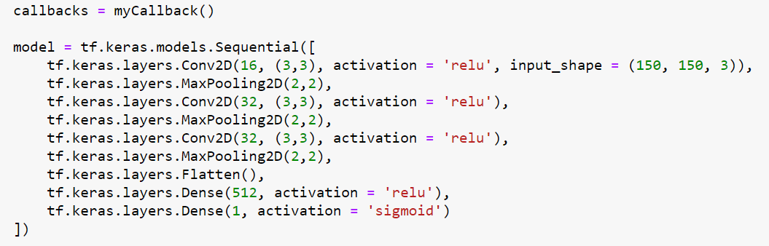
Building the neural network model
We apply convolutions and pooling to reduce computation time.
‘Flatten’ reshapes the dimensions of the input image to a row vector.
‘Dense’ is used to define the number of units in that particular layer.
We use ‘relu’ activation function for all layers except the output layer where we use the sigmoid activation function.

Slide 26
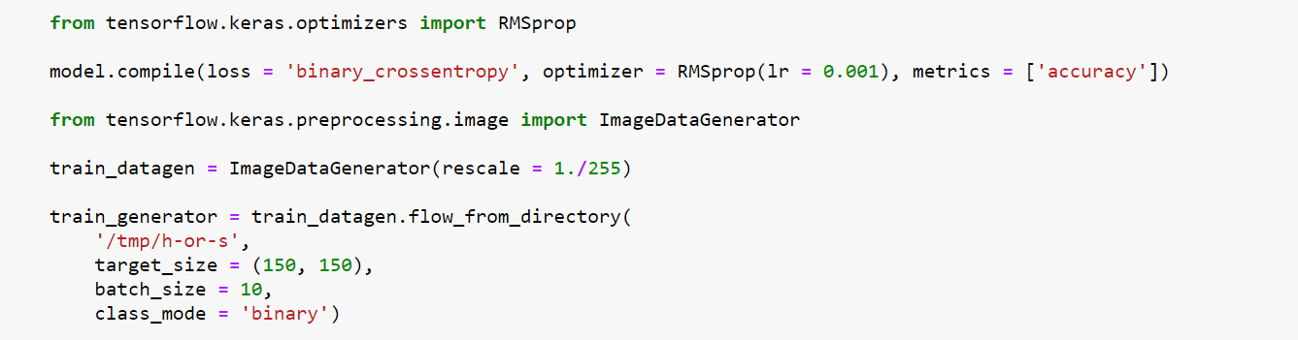
Propagating through neural network
We compile the model we built. Compiling essentially means defining the optimizing algorithm, the loss function, the batch size etc.
We also normalize the input image for the ease of computation.
We pre-process the dataset before training.

Slide 27
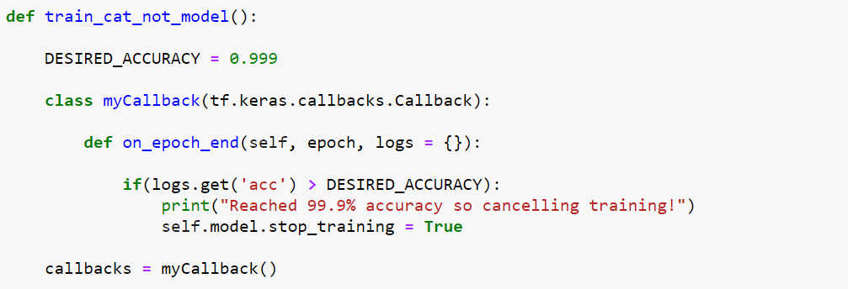
Call-back function
We create a function which breaks the training process after achieving a certain desired training accuracy. In this case we have defined it to be 99.9%.
This function uses a Keras API ‘callbacks.Callback’ which produces a call-back.

Slide 28
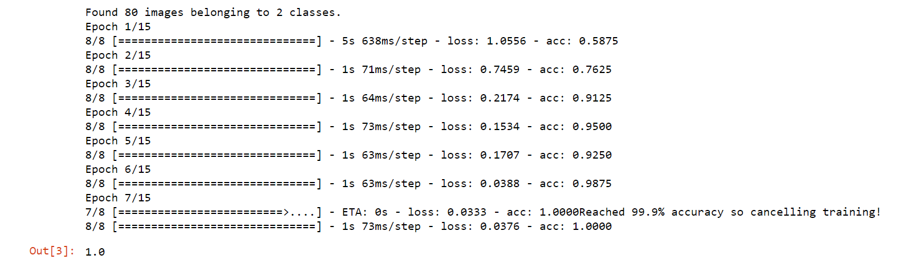
Training the model
OUTPUT:
We train the model on our dataset.
We get the following output.

Slide 29
Face-Mask Detector
Using TensorFlow and Keras

Slide 30
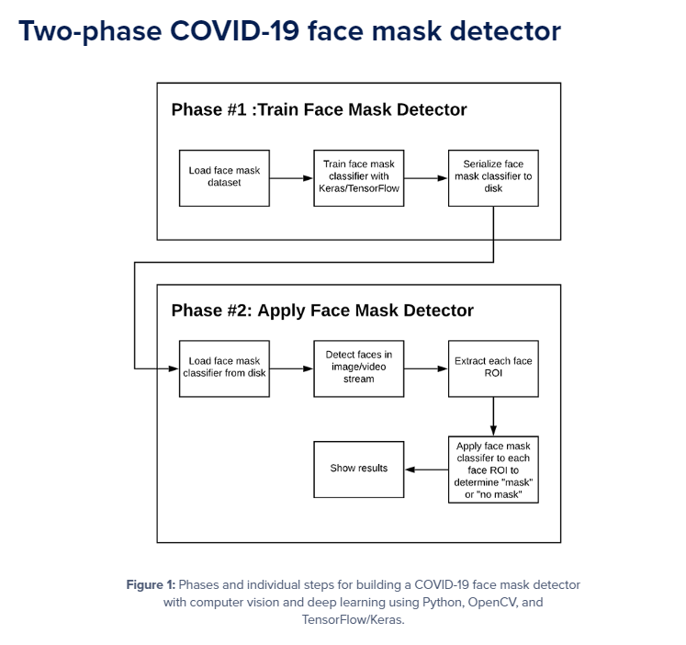
Source- COVID-19: Face Mask Detector with OpenCV, Keras/TensorFlow, and Deep Learning

Slide 31
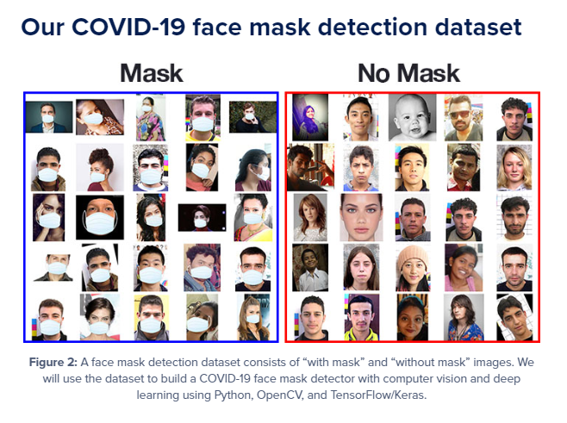
Source- COVID-19: Face Mask Detector with OpenCV, Keras/TensorFlow, and Deep Learning

Slide 32
Building and Training our Model

Slide 33
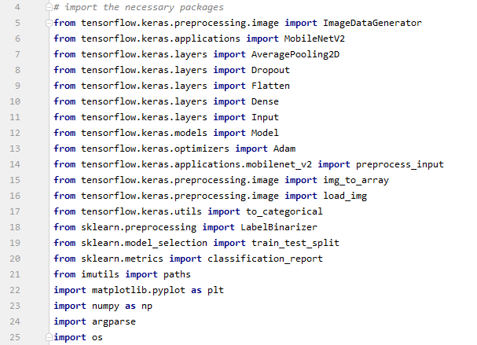
Importing Libraries, Packages and Dependencies
TensorFlow.keras provides the basis of all the functions that we are going to use in our program.
Other libraries include functions to plot graphs, pre-process the input and access the system’s directories.
Sklearn is another math library commonly used in ML algorithms.

Slide 34
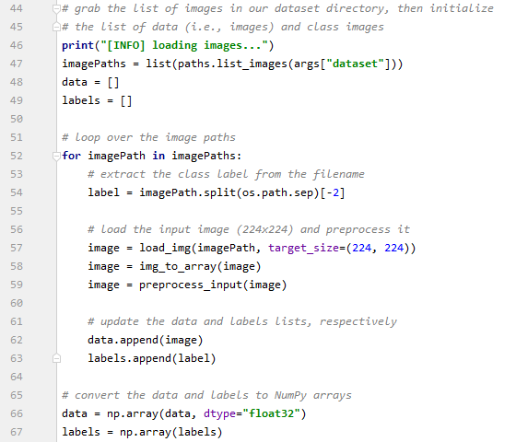
Loading the Dataset
We hardcode the hyper-parameters and keep it in one place.
We load the dataset and pre-process it.
The dataset is then converted to a NumPy array. This allows computational efficiency.

Slide 35
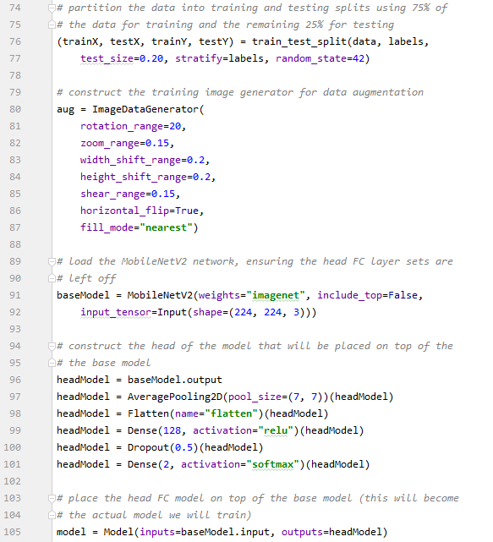
Building the Neural Network
We divide our dataset between training and testing.
Data-augmentation is performed only for the training part.
We construct the structure of the neural network. The final activation function we use is the softmax function.

Slide 36
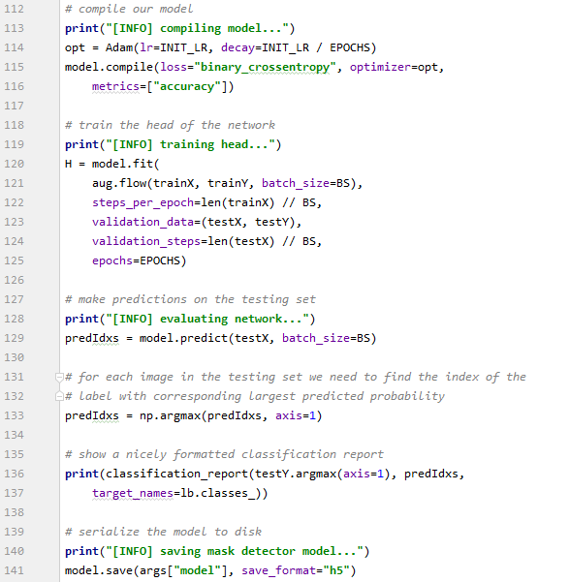
Compiling the Model
We define our optimizer and loss function.
Train our model on the provided dataset.
We use a separate validation dataset, to check our training after each epoch.
Save the model.

Slide 37
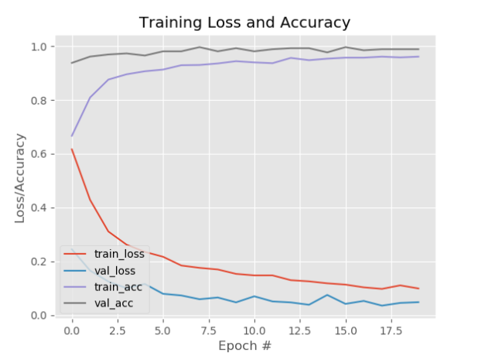
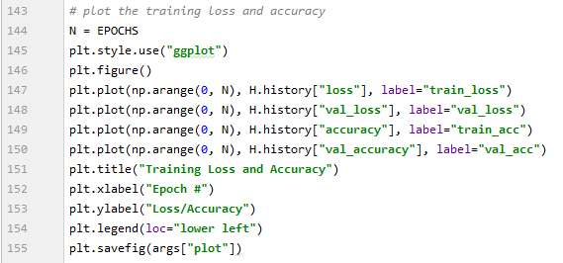
Plot the Graph

Slide 38
Detecting Face-Masks on Images

Slide 39
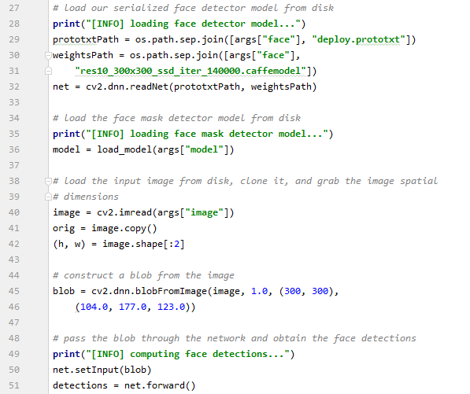
Detecting the Face in the Image
We load the face-detector model from the OpenCV library.
Pre-process the image that is fed and extract the blob.
Detect the face in the blob.

Slide 40
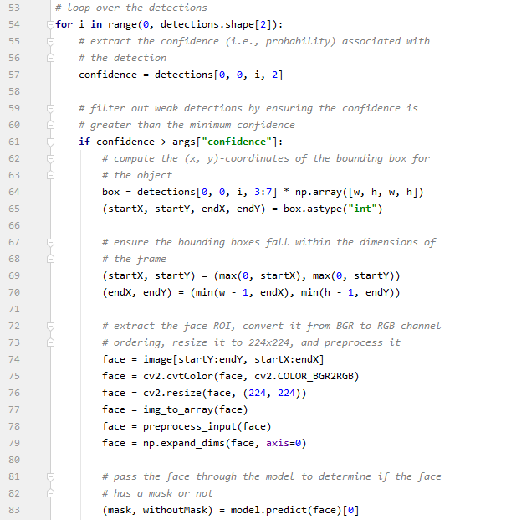
Confidence Threshold
We build a confidence threshold which rejects face-detections below a certain confidence.
Extracting the ROI or the region of interest, we feed the pre-processed image to our mask detector model and predict whether the person is wearing a mask or not.

Slide 41
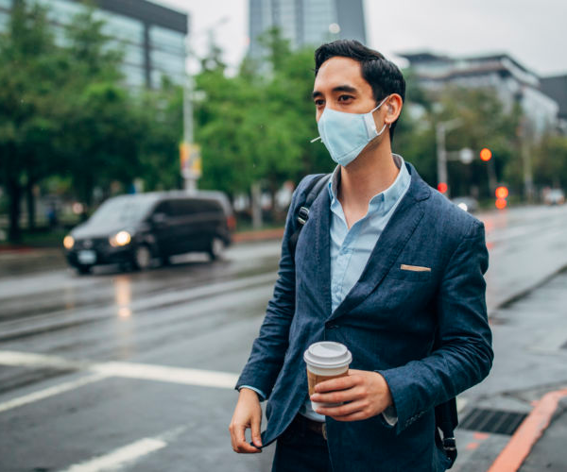

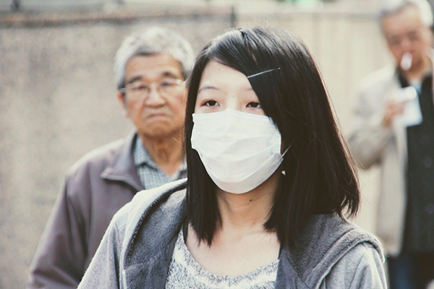

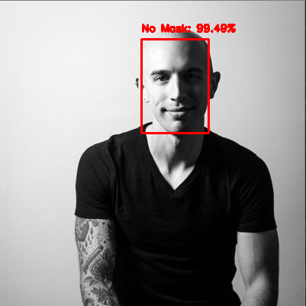
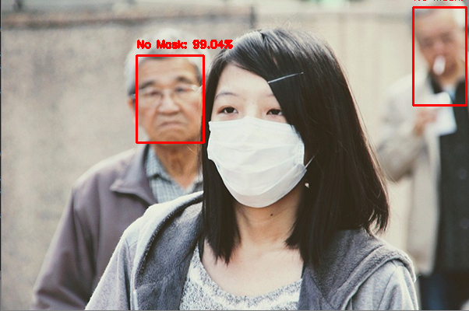
Examples from our Neural Network Model

Slide 42
Detecting Face-Masks during Videos

Slide 43
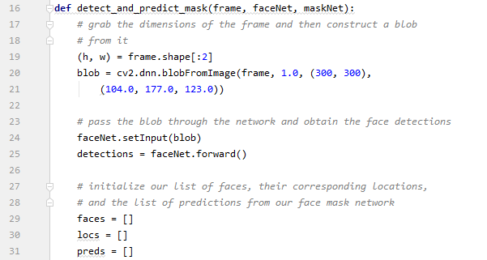
Detecting the Face in Multiple Frames
Take a particular frame and grab the blob from the image.
Detect the face on the blob.
Initialize variables to store the locations of the face in the particular frame.

Slide 44
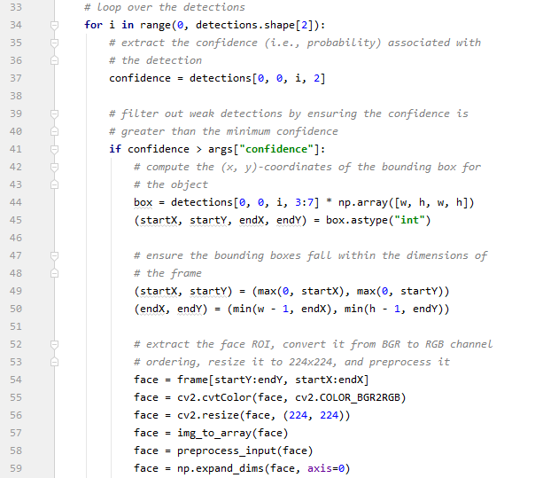
Confidence Threshold
We do the same operation as we did before on a single image. This time we do it on a single frame.

Slide 45
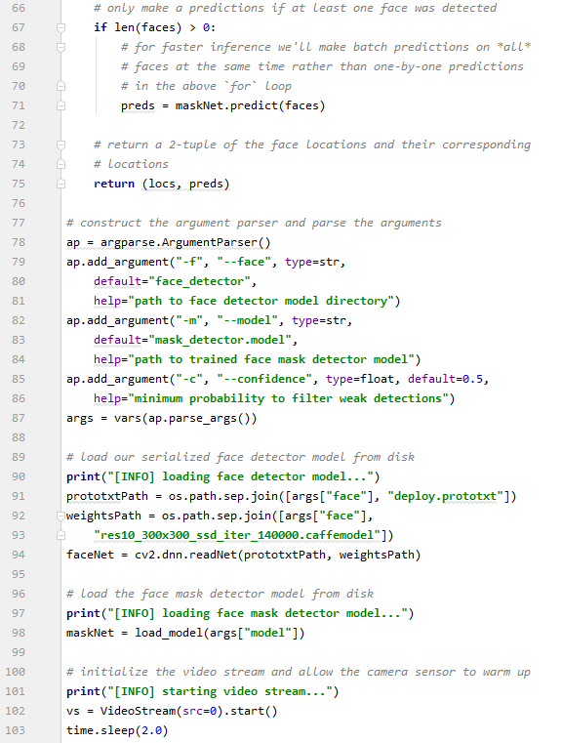
Store the Information of Multiple Frames
We detect the face mask only if more than one face was detected in the corresponding frames.
The video stream through our web cam is started with a brief delay.

Slide 46
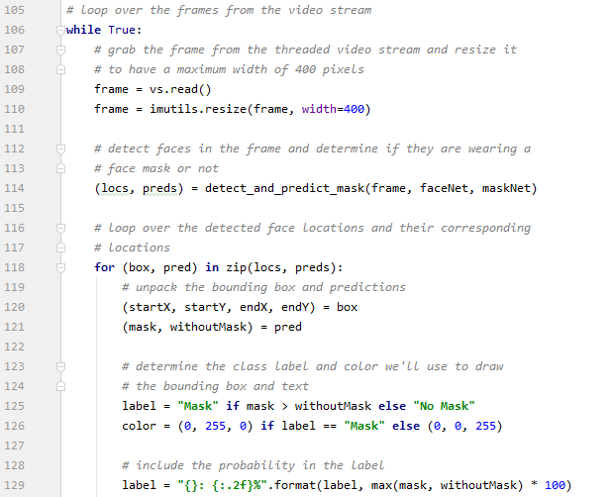
Loop over the Video
While the web cam is on, we pass the frames to our function and predict whether the person is wearing a face mask or not.
A label is displayed with a confidence value around the face. The value is a measure of the model’s confidence in providing the correct result.

Slide 47
Loopholes in our Model
Our model is not able to detect faces which are largely covered with masks. The mask obscures with the face-detection process and hence it is not able to pass the confidence threshold.
The model is only able to detect light-coloured masks and fails to detect other dark colours. This is due to the training dataset which only contains light-coloured masks.
The model is susceptible to over-fitting. This happens when the model is generalized to the training dataset and fails to classify the testing dataset correctly. This happens when the dataset is not large.

Slide 48
How can the Model be Improved
Insert more layers into the neural network. More layers will help to recognize parts of the face better and hence the model would be able to have high confidence value on the face detections.
Improve the dataset by increasing the diversity of the training images. Artificial datasets could hamper the performance of the neural network.
Increase the number of training data and apply fine-tuning. DropOuts, Regularization are some of the techniques through which we could fit our data better in the model.

Slide 49
References:
COVID-19: Face Mask Detector with OpenCV, Keras/TensorFlow, and Deep Learning (https://www.pyimagesearch.com/2020/05/04/covid-19-face-mask-detector-with-opencv-keras-tensorflow-and-deep-learning/)
Deep learning: How OpenCV’s blobFromImage works (https://www.pyimagesearch.com/2017/11/06/deep-learning-opencvs-blobfromimage-works/)
TensorFlow Documentation (https://www.tensorflow.org/api_docs/python/tf/keras/Model)
Keras Documentation (https://keras.io/documentation/)
Coursera- Neural Networks and Deep Learning (https://www.coursera.org/learn/neural-networks-deep-learning/home/welcome)
Coursera- Introduction to TensorFlow for Artificial Intelligence, Machine Learning, and Deep Learning (https://www.coursera.org/learn/introduction-tensorflow/home/welcome)

Slide 50
THANK YOU

